Slide 1
Microverse Fights
A 2020 Javascript Phaser Multiplayer game

Slide 2
Basic Gameplay
PC based web app
Players can gain points by collecting stars or killing other enemies/players (1 star = 10 points, 1 enemy = 100 points)
Players and enemies can shoot lasers on each other, if they collide they both die
With each star collected or enemy killed your laser scale increases until you die and it resets to the initial scale.
When you die you are set to a random place in the map in shielded mode until you first move or shoot
All enemies have a different color/shape than the user.
The player movement is airplane based (up accelerate, left/right for the angle)

Slide 3
Gameflow
User visits the website
He receives a form to add a nickname.
They are redirected to the TitleScene/MainMenuScene where they can opt to play or watch the battlefield
If they select play they join the battle
If they select watch they will appear in the sidebar with the score replaced by `watch`

Slide 4
Scenes
Get a form to request a nickname
Boot
Preloader
MaineMenuScene/Title
Game
Credits

Slide 5
Extra functions
Your score will automatically be registered when you disconnect
Left side-bar:
Showing current online players count
Current online players nickname and scores
Right side-bar:
Showing first 10 highest scores of all time

Slide 6
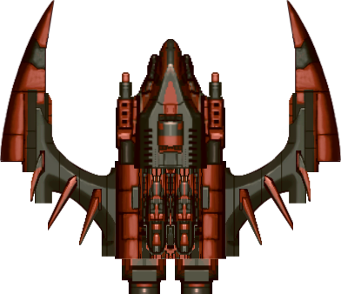






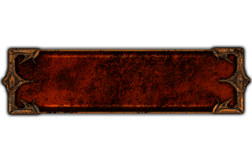
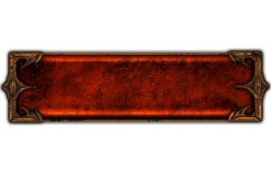
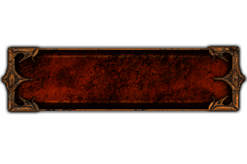

Graphics
Player
Enemy
Lasers
Buttons
Star
Explosion:
Shield:

Slide 7

Sounds
Collect Star
Explosion
Laser
Background music
Player Joined
Button press
Button Hover
Open the Power Point version of the file (.pptx) if you want to listen the audio files

Slide 8
First round of nice-to-have
Add shield until first movement
Add request nickname input
When you collide with other player both should be bounced
When you die you can select revive or watch mode
Add credits scene with details related to the project

Slide 9
Super improvements
Spawn 1 kind of enemy from time to time when there is only one player in the game
Make the map bigger then the viewport and users can navigate through it

Slide 10
Credits
Includes graphics from JS WARS by Jonas Wagner - http://29a.ch/
Thanks kalface@gmail.com blog: http://carlosalface.blogspot.pt/
Some of the sounds in this project were created by David McKee (ViRiX) soundcloud.com/virix
Sound On Off Images: Aaron Burke (itmatters.mobi)

